Slide 1

The Red Record by Ida B. Wells-Presentation
Team 3
Jan 192023

Slide 2

Team 3
Dereck Sands –Data Architect
Ayoyemi Hamzat – Project Manager
Emmanuel Adeyemi – Business Analyst
Anup Gautam – Data Scientist
Keshav Shah– Data Analyst
Krishna Sah Kanu – Data Engineer

Slide 3
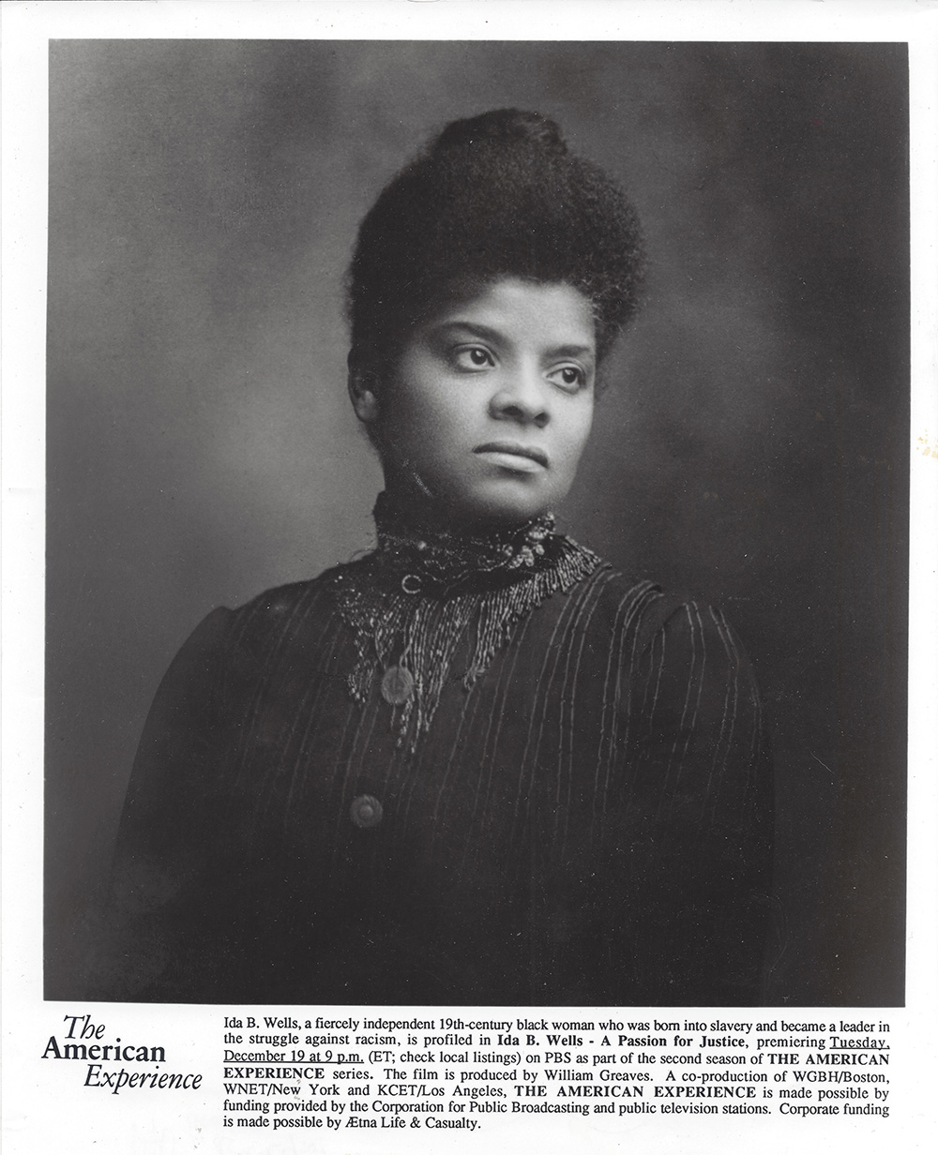
Ida B Wells
Ida B. Wells was an African American journalist, abolitionist, and feminist who lived in the late 19th and early 20th centuries. She is best known for her investigations and writings on the issue of lynching in the United States, which helped to bring national attention to the practice. She also worked to secure voting rights for African Americans and to improve educational opportunities for black children. Wells was an influential leader in the civil rights movement of her time and continues to be recognized for her contributions to the struggle for racial equality.

Slide 4
WHAT DID IDA B. WELLS DO?
DATA MODELLING
DATA STORYTELLING

Slide 5

1.Data Modeling Wells-Barnett catalogued details about lynching by region and noted differences in the types of "crimes" that were more commonly used as justification for lynching.

Slide 6
2.Data StoryTelling Documented her findings independently, by self-publishing her work. Today, data findings can be disseminated through various platforms such as social media, computers, blogs, and newsletters. It's hard to say which social media platforms Wells-Barnett would have used, but she would have likely chosen platforms that allow for the most reach and visibility for her message.

Slide 7
How was the Data Collected
Ida B. Wells collected data on lynching in the United States in the late 19th and early 20th centuries by researching newspaper reports and conducting interviews with witnesses and survivors of lynchings.
She also compiled statistics on the number of lynching that occurred each year and the reasons given for them.
Additionally, she traveled throughout the South to investigate lynching and gather firsthand accounts of the events.

Slide 8
DATA on State and Crime

Slide 9
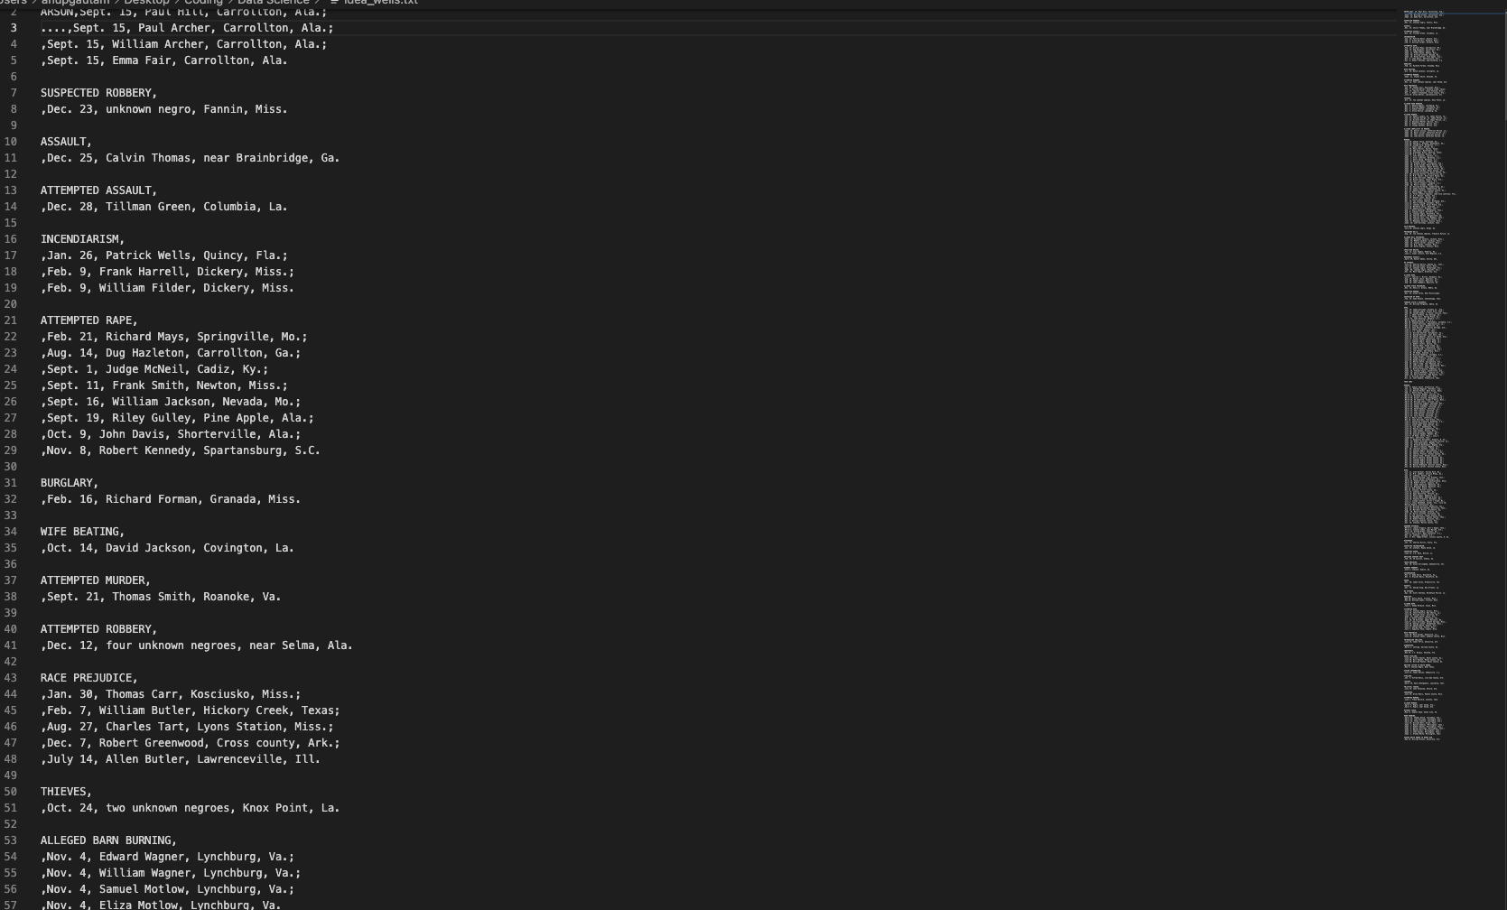

Slide 10
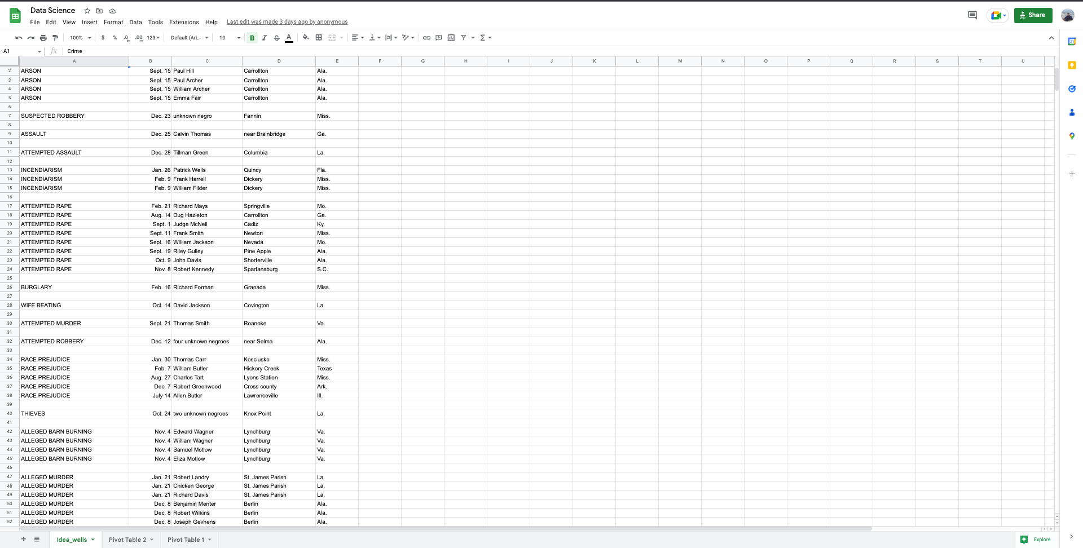

Slide 11
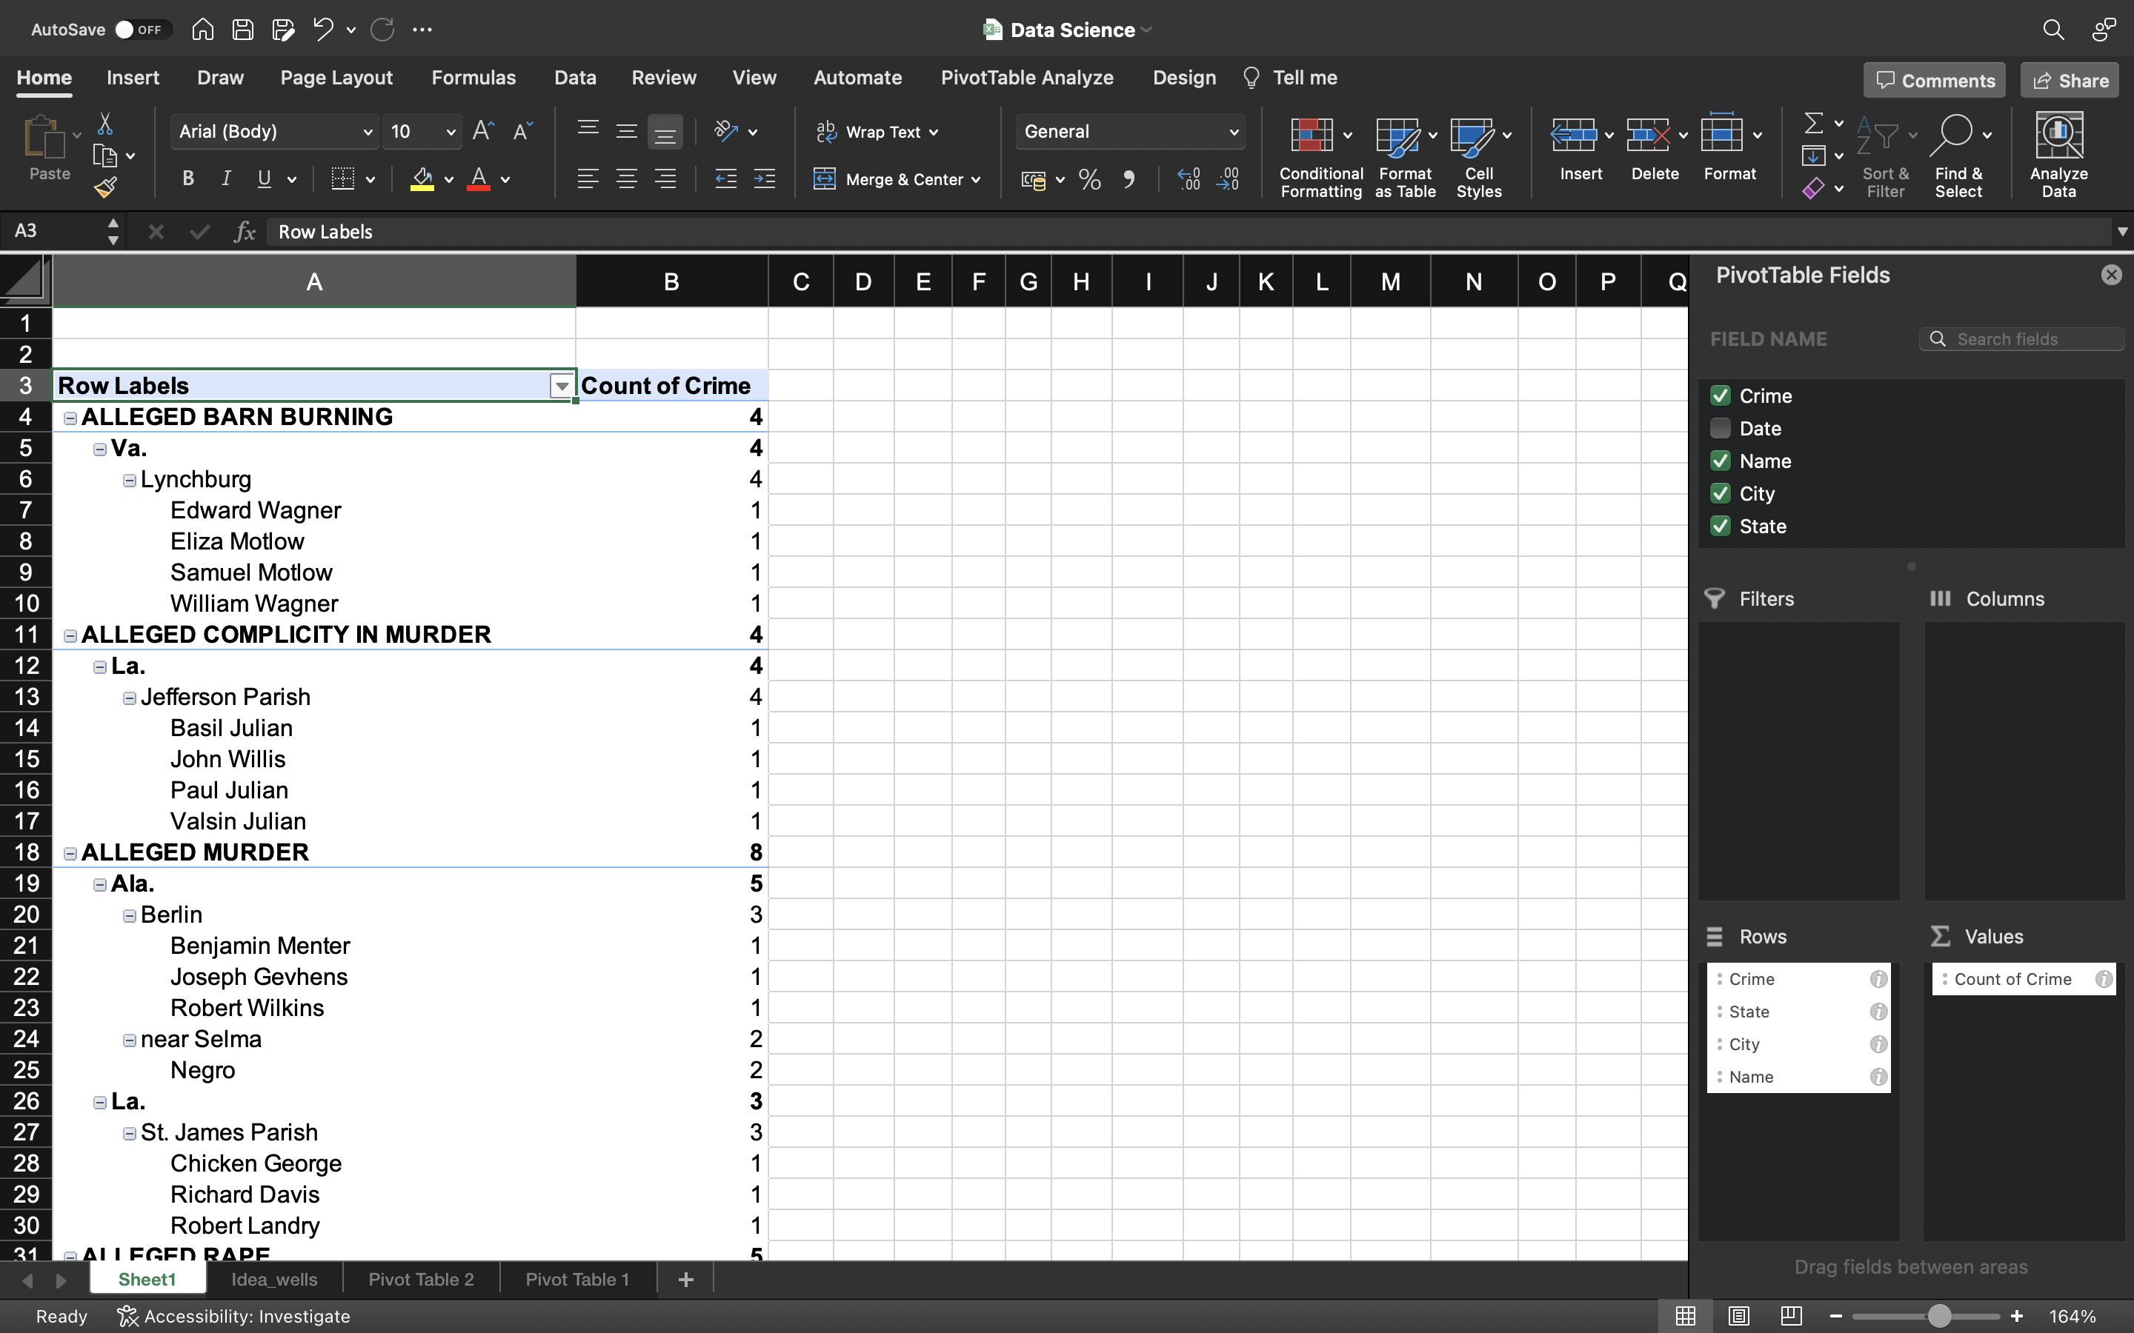

Slide 12
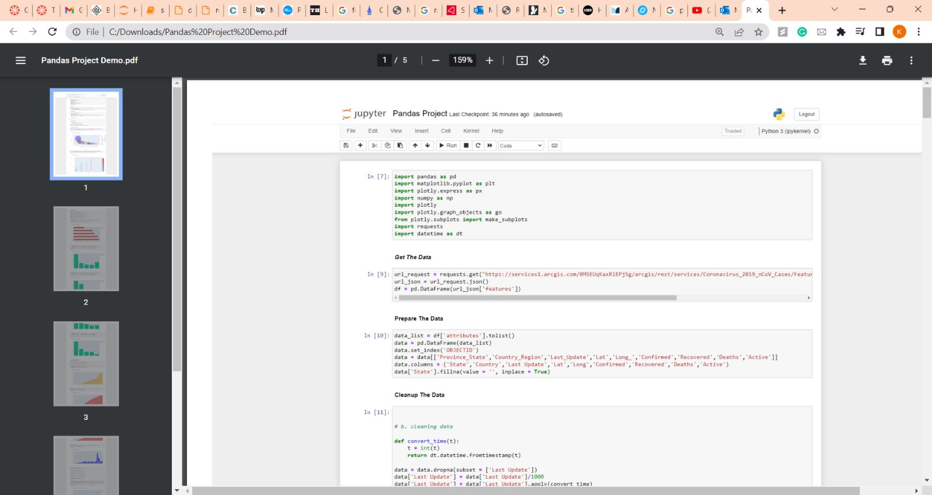

Slide 13
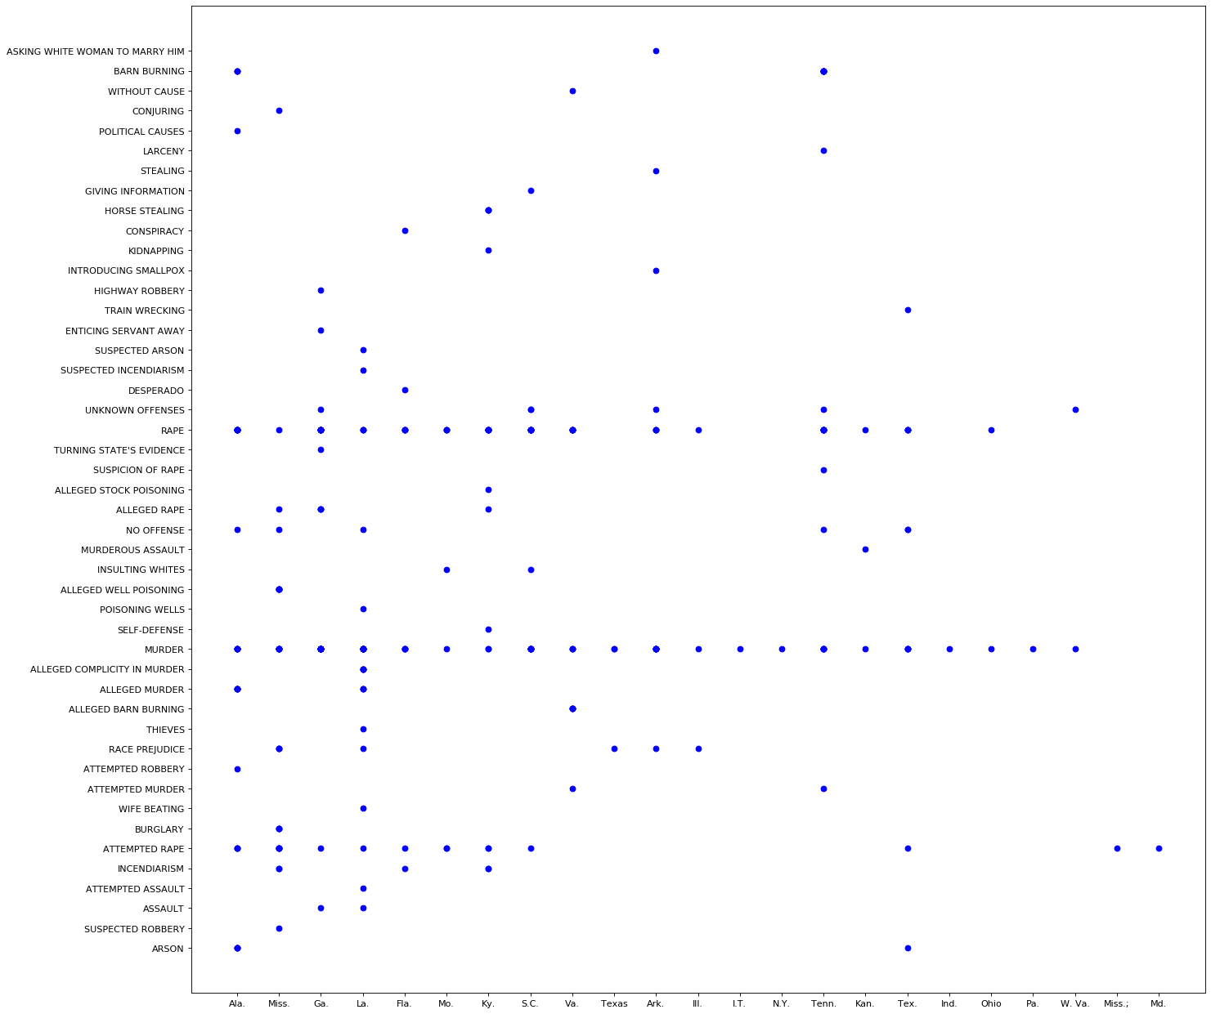

Slide 14
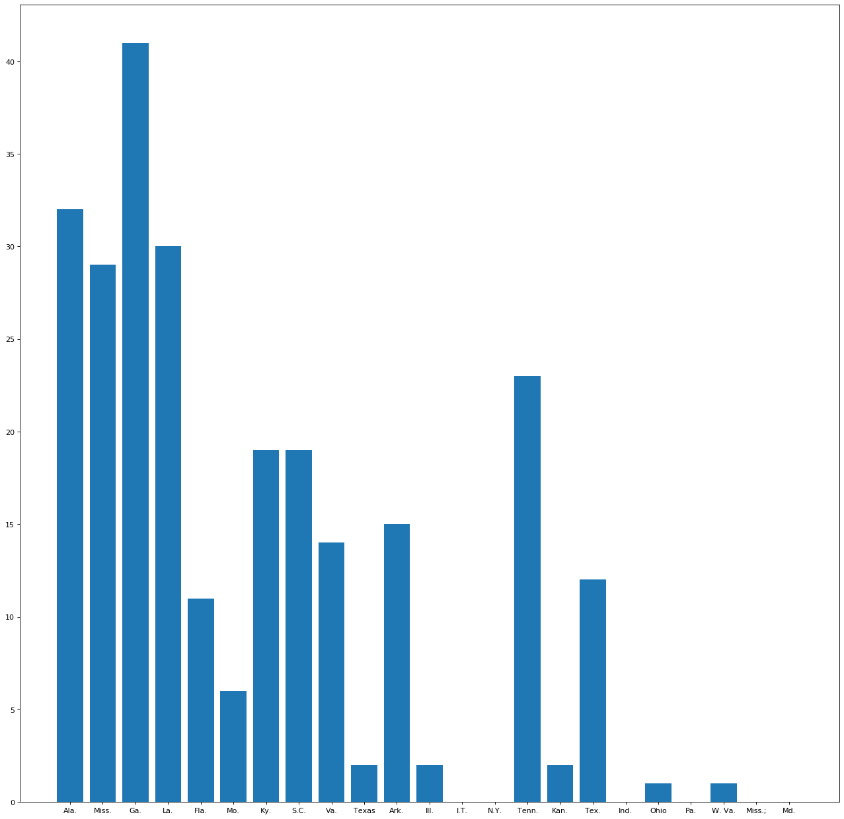

Slide 15

Thank You

